Slide 1
Topic: How will Brexit affect logistics and trade?
Nick Fox
June 2020

Slide 2

Time to take a view

Slide 3


Slide 4
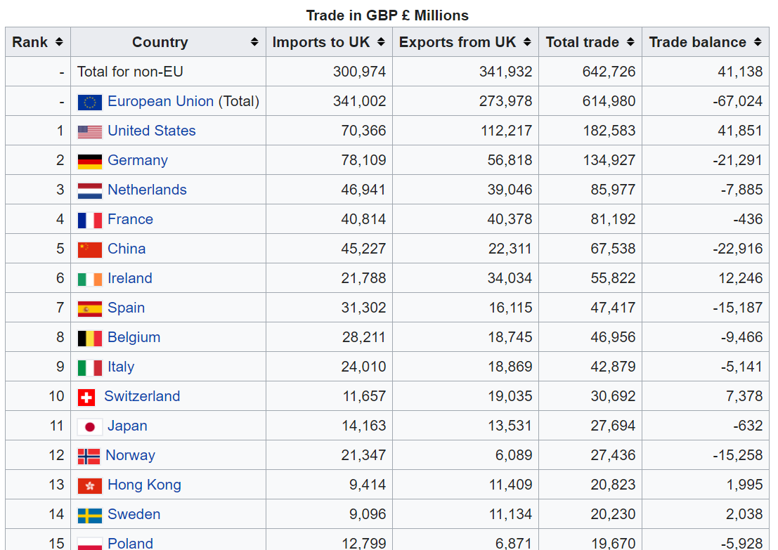
2019 Figures

Slide 5
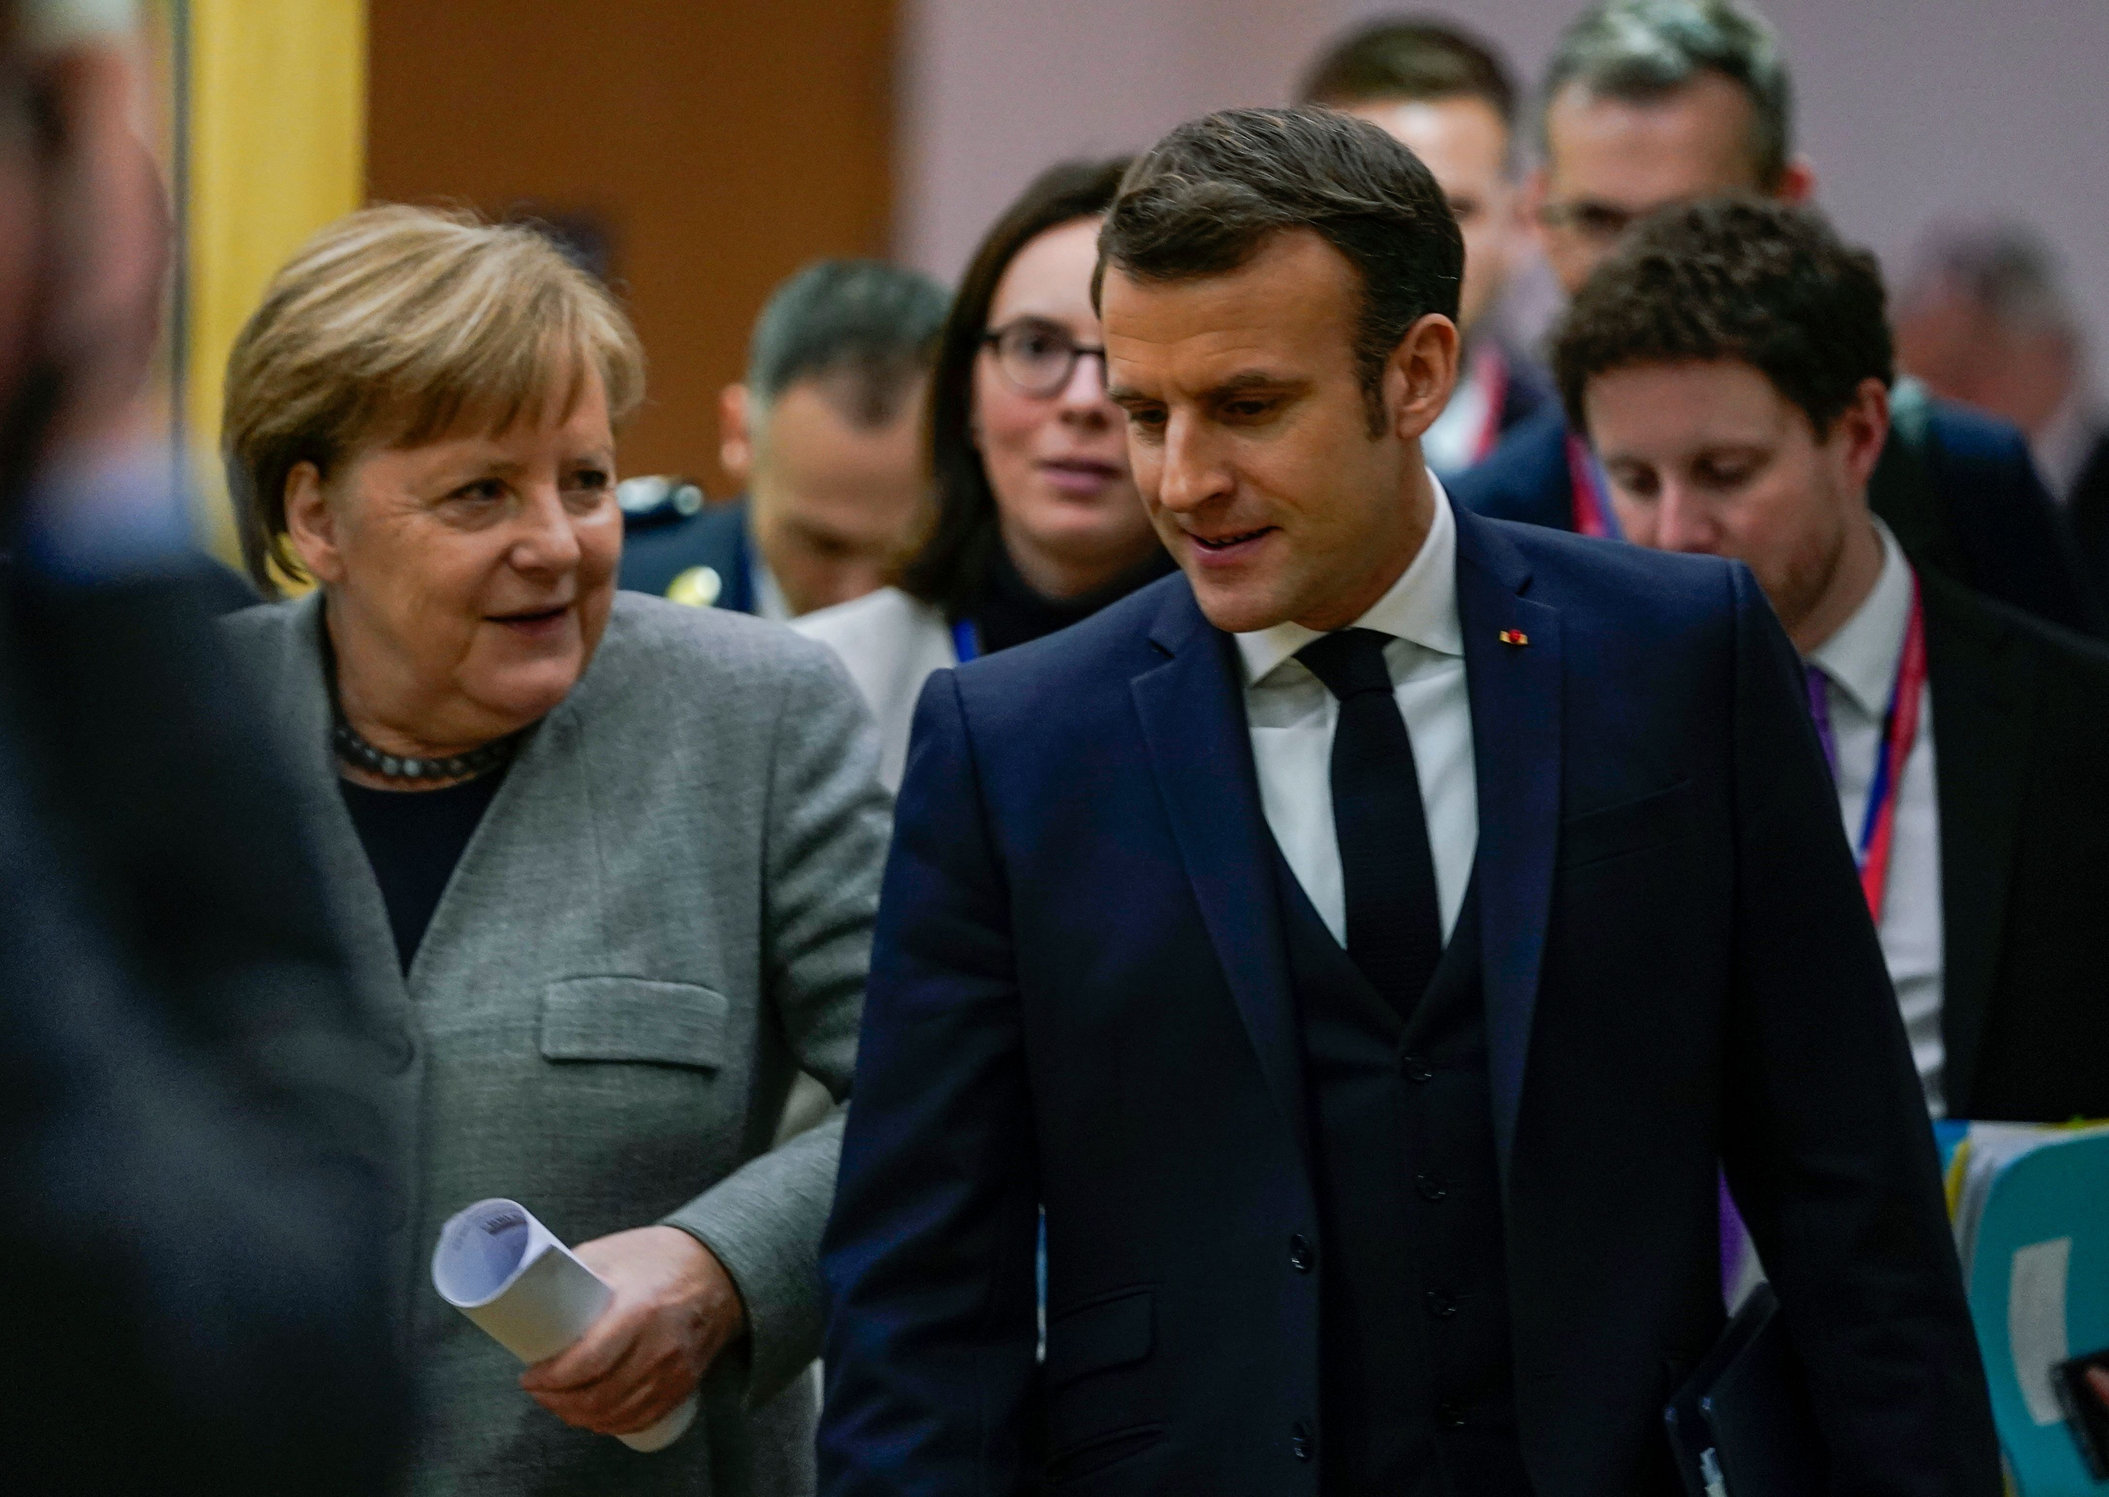



Issues in the EU now

Slide 6


Slide 7

Enter Data at Source
No spread sheets, word documents or PDFs
The computer tells us what to do
To manage Brexit you need to manage your data!

