Slide 1

Parcels, Pets & PPE
A gallop through 2020 looking at the logistics property deals that defined the logistics market and what it says about how the UK logistics market kept the nation going while we were all in lockdown.

Slide 2
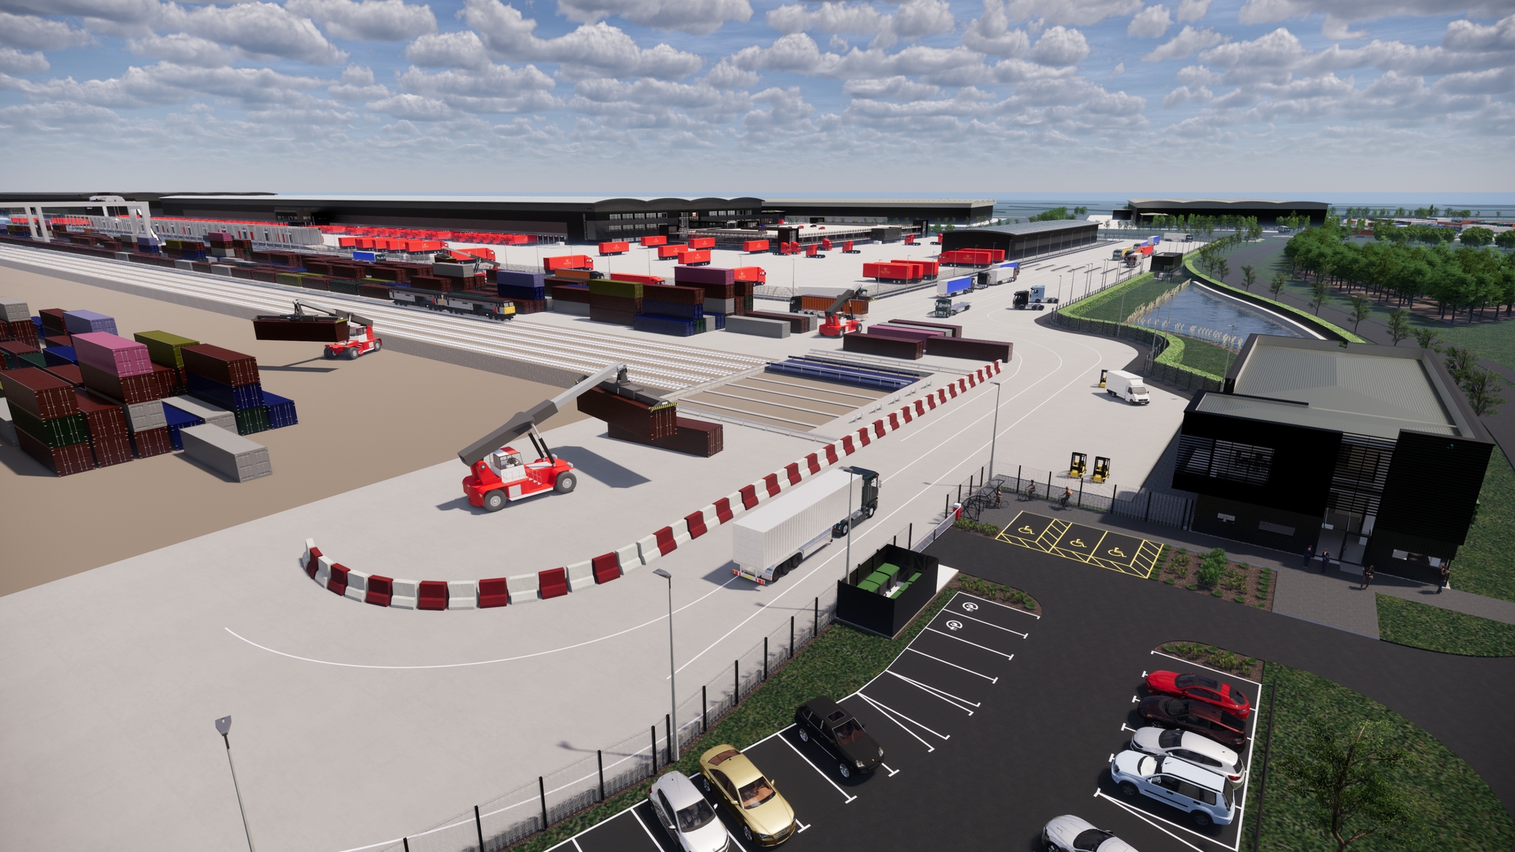
Royal Mail, DIRFT III
Notes:
840,000 sq ft build-to-suit deal with Prologis on its 7 m sq ft DIRFT III development in the East Midlands. The facility will have the capacity to process over 1 million items per day and will be the largest Royal Mail parcel hub in the UK.
The Royal Mail recorded that it handled more parcels than letters in 2020 for the first time ever peaking with 11.7 million parcels delivered in a single day. Parcels have prevented the Royal Mail from being consigned as a mere footnote in history.

Slide 3
Parcel power
Total of 2.8 billion parcels were sent in the UK in the fiscal year 2019/2020 – an increase of 209 million parcels relative to the year before – around 7.5% increase
But what about 2020?
Royal Mail parcel revenue increases to 37% (Source: Royal Mail)
Hermes parcel numbers increase 250m to 630m – up 39% (Source: Hermes)
DHL Express sees global network to rise by over 50% (Source: DHL)

Slide 4
Online sales
Online sales increased 74.4% y-o-y to November 2020 (Source: Statista)
Online sales as a % of total retail sales 36.2% (Source: ONS)
John Lewis online sales are 60-70% - up from 40% pre-pandemic (Source: John Lewis)
Next plc online sales 7% higher than retail sales at 49% increasing 10% y-o-y (Source: Next plc)
M&S online sales increase 34.7% - non grocery (Source M&S)

Slide 5
Top Parcel Carriers by volume
  Royal Mail 35%
        Amazon Logistics 15%
        Hermes 10%
        UPS 8%
        DHL 7%
Source: Pitney Bowes Parcel Shipping Index

Slide 6
Space Race
In the year to date Logistics Manager reported on :
4.4 million sq ft of warehouse space take-up by parcel companies
29 individual deals involving parcel companies
11 separate parcel companies

Slide 7
Space Race
Notes:
In 2014 Amazon Logistics only made up 4% of the parcel delivery market by volume. Amazon in the last 12 months has taken or is set to take some 20.27 million sq ft in 30 deals for distribution centres, delivery depots and parcel hubs – and there is more to come…Talking with property agents and developers in the UK at the beginning of the year and Amazon is rumoured to be actively seeking to let or secure under offer between 40 and 75 facilities in 2021/22. Not all of these will be directly for its Amazon Logistics arm – but if your property has not got Amazon after it you might like to ask what’s wrong with it

Slide 8
Space Race
DPD announced that it would be looking for 15 new regional depots in 2020 - an increase on the 10 originally planned (Source: DPD)
Hermes looked to secure 90 sub depots (Source: Logistics Manager)
DHL announced 5 new depots (Source: DHL)
Amazon to secure 40 facilities in 2021 (Source: Logistics Manager)

Slide 9
Space Race
Oxenwood saw the letting of its 78,650 sq ft warehouse Logistics 15 in Weybridge to Hermes Parcelnet happen within days.
The unit became vacant and Hermes, which took a 15 year lease on the building at £15.15 per sq ft, took possession and sorted fit-out to have the building operational within eight weeks.
Notes:
There is a huge demand from parcel carriers and couriers across the UK, and while a lot of them are looking for sub-100,000 sq ft unit, securing larger strategically placed parcel hubs is equally important. [Yodel is in the process of securing a northern hub – watch this space…] This is all about market share/dominnance as welll as getting and filling in the gaps within the delivery network to provide same day and next day delivery as demanded by the customers ..because whatever the new normal is when we are finally free of lock down and other pandemic restrictions – because we are all now tech savvy across the genreations people will be living, working and shopping very differntly than before.

Slide 10
Jobs
Royal Mail kept on 10,000 temporary workers after Christmas 2020
Hermes announced 10,500 jobs in July 2020
DPD announced 6,000 jobs in July 2020
Amazon announced it would increase UK workforce by 10,000 in 2020*
There are currently 188,000 courier vacancies in the UK (Source: Quadrotech)
*only some will be for directly employed Amazon Logistics positions
Notes:
This new normal that we are hopefully going to see this year won’t be good for everyone and there has, and will be, a lot of job losses. I think job losses across the hospitality and retail sectors have been predicted to be upwards of 400,000 - but it certainly seems like the logistics sector as well as supporting us when we were in lockdown could also be in a position to provide plethora of new jobs going forward – for as well as the courier posts there are a myriad of skilled and semi skilled jobs within the rest of the logistics sector

Slide 11
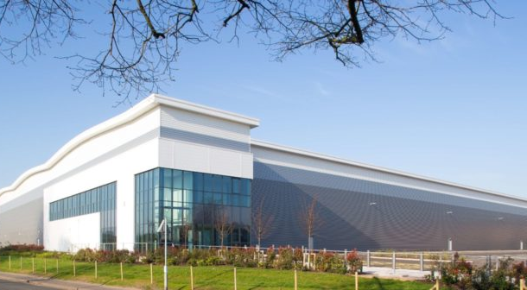
Pets At Home, Stafford
Notes:
Pets At Home taking a 20 year lease on 670,000 sq ft national storage and distribution centre in Redhill Business Park, Stafford. The £48 million facility will be developed by Stoford Developments
So busy has the company been that it had to secure extra space to cater for demand in 2020 by taking a two-year lease on a 141,000 sq ft distribution unit in Stoke-on-Trent from LondonMetric in June.

Slide 12
Pandemic Puppy
In February 2020 the PDSA reported that 51% of UK adults own a pet.
  26% have a cat - 10.9 million pet cats
  24% have a dog - 10.1 million pet dogs
5.7 million new pets were bought between March and September 2020 - including 2.2 million pet dogs (Source: FT)
a 78% increase in people registering new pets with insurers in the week prior to the first lockdown
Notes:
During the lockdown in Spain, dog walking was allowed, whilst children were confined to their homes for 45 days … good to know we are not the only national of dog lovers....

Slide 13

Pandemic Puppy
UK pet industry valued at £6.3 billion in 2019
Pet owners spend:
  £2.8 billion on pet food every year
  £2.5 billion on veterinary care every year
Spending on pets has grown by 7% annually over last five years

Slide 14
Pandemic Puppy
Globally, pet supplies saw a 60% increase in online sales in 2020 (Source: Nosto)
PetShop.co.uk saw 300% uptick in sales at the height of the first lockdown (Source: Petshop.co.uk)
Pets At Home saw omnichannel revenue growth of 65.8% to £77.1m, representing 15.2% of total Retail revenue in the last six months of 2020 (Source: Pets At Home)
Notes:
Pet retailers and indeed pet food manufacturers and distributors have been busy (seriously independednt dog food manfacturers such as Lilys and bespoke pet food maker Tails.com have been part of bidding wars by the big conglomerates such as Nestle: it was a dog eat dog world out there – and it looks like that activity will continue who says in the new normal that we won’t be taking our dog, cats, or even rabbits to work and not just on Bring Your Dog to Work Day (June 25th 2021)

Slide 15
An Extraordinary Year
Notes:
There can be no doubt that the world has changed - how we live our lives on a day to day basis: how we work, how we shop and how we socialise but we were already on that path as part of a technological revolution: the issue is that the pandemic has propelled that revolution forward by half a decade within half a year. The rapidity of that change could have crippled economies the world over but for one thing: logistics. Without the supply chain industry’s resilience and ability to flex economies the world over would have been even more severely impaired, leading to political instability and worse. It sounds dramatic but enforcing people to stay at home in order to save lives and beat covid-19 could only ever have been achieved with the guarantee that supply chains would be able to keep the populations fed and watered, that the supply chains would be able to keep hospitals well provisioned, that the supply chains would in essence keep the world turning in our absence. They brought the world to us when we could not go out into the world.

Slide 16
The total combined UK revenue for the 100+ companies surveyed in the Barclays-BDO Logistics Confidence Index is £16.4bn - even under current conditions
Nearly half (49%) still expect to see profits increase over the next 12 months. (Source: Barclays-BDO Logistics Confidence Index )
Total take-up of logistics warehouse space over 50,000 sq ft in the UK in 2020 reached 56.6 million sq ft (Source: Gerald Eve)

Slide 17

NHS Nationwide

Slide 18
Any questions?

Slide 19

Thank you to our sponsors

